Slide 1
Investigating Causal Bootstrapping for Parkinson’s Telemonitoring Data
Understanding the impact of subject-level confounding on causal inference
Notes:
My dissertation is investigating causak bootstrapping using the UCI Parkinson’s Telemonitoring dataset. The project originally began as a comparison between causal and standard associational modelling, but EDA and discussions have highlighted a potentially important issue regarding subject confounding.

Slide 2
Original Aim
Initial question: Can causal bootsrapping provide advantages over a standard associational model when modelling the relationship between Parkinson’s severity and voice measurements?
Initial plan:
Adjust for age and sex confounding
Apply causal bootstrapping
Compare against a standard associational model
Notes:
My inital question was wether causal bootstrapping could provide advantages over a standard predictive approach when modelling the relationship between Parkinson’s severity and voice measurements. At this stage I was treating age and sex as the primary confounders.

Slide 3
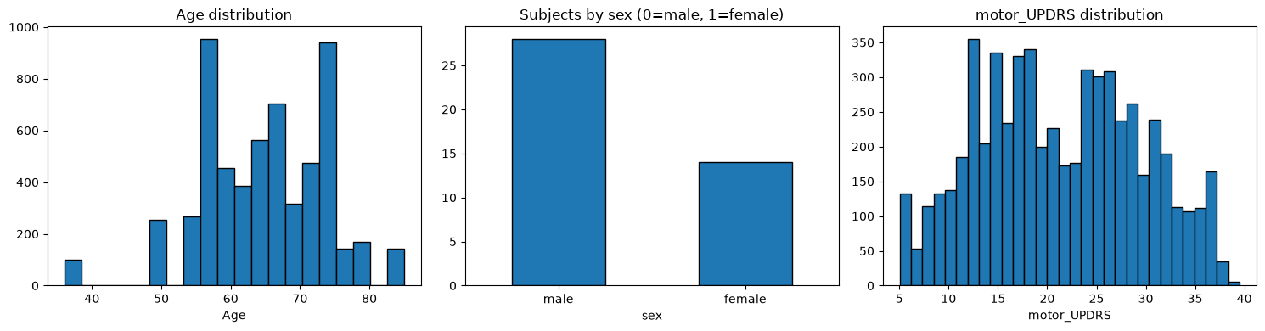
Dataset: UCI Parkinson’s Telemonitoring
Shape: 5875 recordings, 22 features
Voice Features:
16 voice features recorded over a 6 month period
42 Parkinson’s patients
28 Males, 14 Females
Age range: 36-85
Recordings per subject: mean 140, std 15.5
Notes:
Dataset contains nearly 6,000 recordings collected from only 42 patients over a 6 month period.

Slide 4
Initial Causal Graph
Age → UPDRS
Age → Voice
Sex → UPDRS
Sex → Voice
UPDRS → Voice
Assumptions:
Age affects both disease severity and voice
Sex affects both disease severity and voice
Parkinson’s severity affects voice characteristics

Slide 5
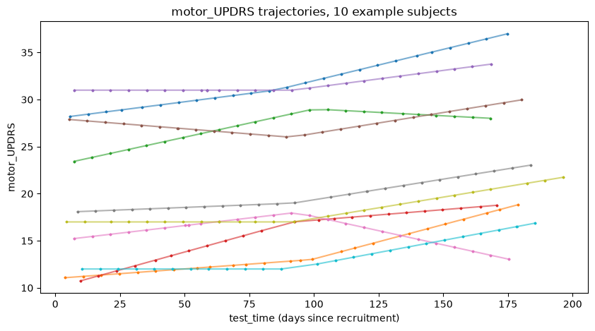
UPDRS Progression by Subject
Different baseline values
Different progression trajectories

Slide 6
Discovery: Identity as a confounder
Identity → UPDRS
Each subject has unique disease progression trajectory
Identity → Voice
Each subject has unique voice characteristics
Age and Sex are largely fixed within subjects.
Thus identity may dominate the confounding structure

Slide 7
Consequence of Strong Identity Confounding
 | Age
 | 65 | 40 | 72
Subject A | x | - | -
Subject B | - | x | -
Subject C | - | - | x
Subjects only occur at their own ages
Age and sex are largely fixed within subject
Many age-identity combinations never occur
Creates sparse support for causal bootstrapping
Potential remedy: Gaussian age smoothing to fill in support holes

Slide 8
Revised Direction
Updated Causal Graph:
Age → UPDRS
Age → Voice
Sex → UPDRS
Sex → Voice
Identity → UPDRS
Identity → Voice
UPDRS → Voice
Current RQ:
“Can causal bootstrapping be applied reliabily when subject identity creates support violations?

Slide 9
Next Steps
How severe are the support violations?
Can gaussian age smoothing repair them?
Does this improve causal bootstrapping relative to a standard model?
Approaches:
Subject-level aggregation
Joint distribution

